Slide 1
Weather forecast web application
Under the guidance of
Dr. G. RAKESH M.C.A., M.Phil. Ph.D.

Slide 2
ABSTRACT
Weather forecasting is the application of science and technology to predict the state of the atmosphere for a given location. Ancient weather forecasting methods usually relied on observed patterns of events, also termed pattern recognition. For example, it might be observed that if the sunset was particularly red, the following day often brought fair weather. However, not all of these predictions prove reliable. Here this application system will predict weather based on parameters such as temperature, humidity and wind. User will enter current temperature, humidity and wind. This Application System will take this parameter and will predict weather (rainfall in inches) from previous data in database (dataset). The role of the admin is to add previous weather data in database, so that system will calculate weather (estimated rainfall in inches) based on these data. Weather forecasting system takes parameters such as temperature, humidity, and wind and will forecast weather based on previous record therefore this prediction will prove reliable. This system can be used in Air Traffic, Marine, Agriculture, Forestry, Military, and Navy etc.

Slide 3
HARDWARE AND SOFTWARE SPECIFICATIONS
HARDWARE REQUIREMENTS:
The above hardware specification was used in both server and client machines when developing
Processor : 16 core processor i3/i5
RAM : 4GB
Hard Disk : 100 GB
SOFTWARE REQUIREMENTS :
SERVER
Front End : Python ,T-kinter
Back End : API (Dataset)
Operating System : Windows 11
CLIENT
Operating System :Windows 11

Slide 4
MODULES WITH EXPLANATION
UI-USER INTERFACE
API INTEGRATION
RESPONSE AND REPORT GENERATION
UI-USER INTERFACE:
Using a user interface (UI) in a weather forecast application serves several purposes, enhancing the user experience and providing valuable functionality.
Here are some reasons why a UI is beneficial in a weather forecast application.
User-Friendly Interaction:
A graphical user interface provides a user-friendly way for individuals to interact with the weather forecast application. Users can input their location or choose from a list of cities using intuitive controls like text inputs, buttons, and dropdown menus.
Enhanced Presentation:
A UI allows you to present weather information in a visually appealing and organized manner. Graphs, charts, and images can be incorporated to convey weather conditions, trends, and forecasts more effectively than raw text.

Slide 5
Real-Time Updates:
Users can receive real-time or regularly updated weather information through the UI. This is especially useful for applications that provide current weather conditions, hourly forecasts, and long-term predictions.
Interactivity:
Users can interact with the application to explore different aspects of the weather, such as switching between temperature units, exploring historical data, or comparing weather conditions for multiple locations.
Alerts and Notifications:
UIs enable the implementation of alert systems and notifications. Users can receive alerts for severe weather conditions, enabling them to take necessary precautions or adjust their plans accordingly.
Integration with Maps:
UIs can be designed to integrate with mapping services, providing users with a visual representation of weather conditions on a map. This can be especially useful for applications that provide location-specific forecasts.
Historical Data and Trends:
Users can explore historical weather data and trends through the UI. This feature is valuable for researchers, businesses, or individuals interested in understanding weather patterns over time.
Accessibility Features:
UIs can be designed with accessibility features to ensure that individuals with disabilities can use the application effectively. This includes features like screen readers, high contrast modes, and keyboard navigation.

Slide 6
API INTEGRATION:
API integration refers to the process of connecting two or more applications or systems by using APIs (Application Programming Interfaces) to exchange data and perform actions. APIs are sets of protocols and standards that allow different software applications to communicate with each other.
Access to Current Weather Data:
Weather APIs provide up-to-date information about current weather conditions, including temperature, humidity, wind speed, and more. Integrating with a weather API ensures that your web application can present users with the latest and most accurate data.
Forecast Data Retrieval:
Weather APIs offer forecast data, allowing your web application to provide users with short-term and long-term weather predictions. This is essential for users who want to plan activities or events based on future weather conditions.
Global Coverage:
Weather APIs often cover a wide range of locations globally. By integrating with a reputable weather API, your web application can provide weather forecasts for a broad spectrum of regions, making it versatile and appealing to users worldwide.
Efficiency and Scalability:
Leveraging a weather API allows your web application to focus on its core functionality without the need to collect and manage extensive weather data. This makes your application more efficient, scalable, and easier to maintain.

Slide 7
Cost-Effective Solution:
Building and maintaining a weather data infrastructure on your own can be resource-intensive and expensive. API integration provides a cost-effective solution, allowing your web application to access high-quality weather data without the need for extensive infrastructure investments.
Focus on User Experience:
By relying on a weather API, your web application can prioritize user experience and interface design. The time and resources saved by using an API can be redirected towards creating a visually appealing and user-friendly application.
Seamless Updates:
Weather APIs are regularly updated with the latest meteorological information. Your web application can seamlessly benefit from these updates without requiring manual intervention, ensuring that users always have access to current weather insights
Scalability Across Devices:
Weather APIs can be leveraged to create web applications that are scalable across different devices and platforms. Users can access weather information on desktops, tablets, or mobile devices, enhancing the application's accessibility.

Slide 8
RESPONSE AND REPORT GENERATION:
When your weather forecast application makes a request to a weather API to retrieve weather data, it receives a response. Proper response handling involves:
Checking the HTTP status code to ensure a successful request
(e.g., status code 200 for OK).
Parsing the response data, which is typically in JSON format.
Handling error cases when the API returns non-successful status codes
(e.g., 404 for not found, 500 for server error).
Providing meaningful feedback to the user in case of errors
Once the weather data is successfully retrieved and validated, the next step is to generate a human-readable report that presents the weather information in a clear and organized format. The report should include relevant details such as temperature, humidity, wind speed, and forecast conditions

Slide 9
RESPONSE HANDLING:
When your weather forecast application makes a request to a weather API to retrieve weather data, it receives a response. Proper response handling involves:
Checking the HTTP status code to ensure a successful request (e.g., status code 200 for OK).
Parsing the response data, which is typically in JSON format.
Handling error cases when the API returns non-successful status codes (e.g., 404 for not found, 500 for server error).
Providing meaningful feedback to the user in case of errors.
REPORT GENERATION:
Once the weather data is successfully retrieved and validated, the next step is to generate a human-readable report that presents the weather information in a clear and organized format. The report should include relevant details such as temperature, humidity, wind speed, and forecast conditions.
User Presentation:
The Generated Weather Report Is Typically Presented To The User In The Application's UI. This Could Involve Displaying The Information On A Webpage, A Mobile App Screen, Or Any Other User Interface Element. The Goal Is To Make The Weather Information Easily Understandable And Accessible To The End User.

Slide 10
DATA FLOW DIAGRAM
Data Flow Diagram For Entire Project
ACQUIER THE WEATHER DATA
INTIALLAIZING THE WEATHER MODULES
USER INPUT
DATACOLLECTION & PRE PROCESSING
START
DATA ANALYZING AND REARRANGENMENT
WEATHER PREDICTION
TESTING MODULES
TRAINED DATA MODULES
OUTPUT
STOP

Slide 11
TABLES conditional tables
Wind speed | Humidity | Farmer | Fisherman | Employee
Low | low | Suitable | suitable | suitable
medium | low | suitable | managable | suitable
High | low | Managable | Not Suitable | Managable
Low | medium | suitable | Managable | Suitable
medium | medium | Not Suitable | Not Suitable | Not Suitable
High | medium | Not Suitable | Not Suitable | Not Suitable
Low | High | Not Suitable | Not Suitable | Not Suitable
medium | High | Not Suitable | Not Suitable | Not Suitable
High | High | Not Suitable | Not Suitable | Not Suitable
SEVERITY | Wind speed | Humidity
LOW | <3.0 | <60
MEDIAM | 3.0-4.0 | 60-80
HIGH | >4.0 | >80

Slide 12
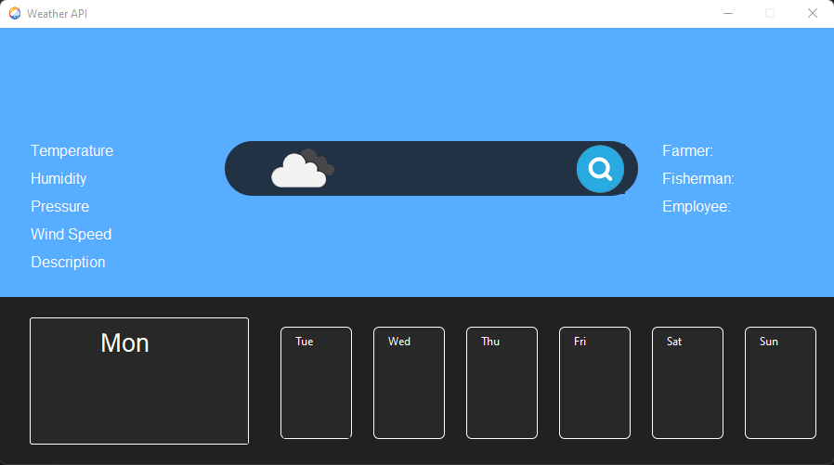
SCREEN SHORTS
THE EXRACT UI OF THE PROJECT

Slide 13
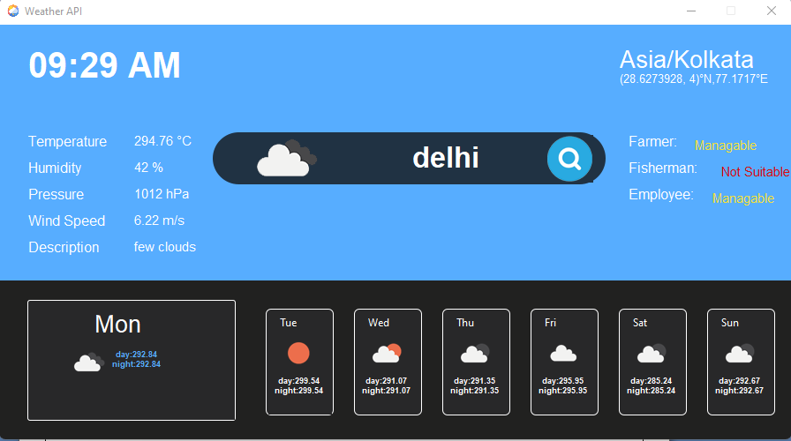
MODEL FOR MANAGABLE&NOT SUITABLE LOCATIONS

Slide 14
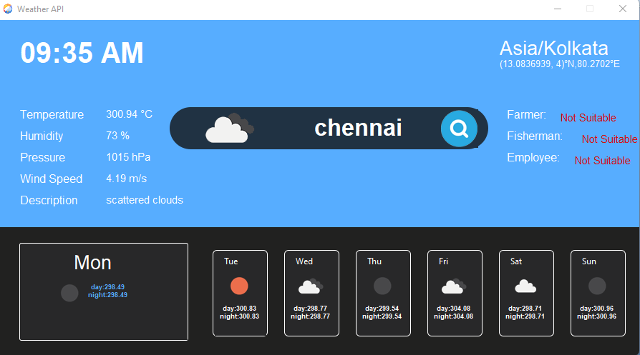
MODEL FOR NOT SUITABLE LOCATIONS

Slide 15
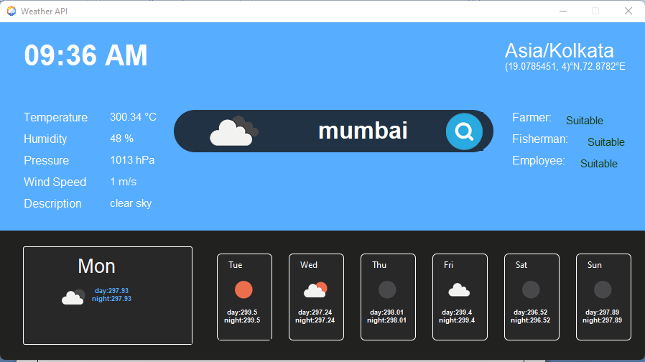
MODEL FOR SUITABLE LOCATIONS

Slide 16
CONCLUSION
Weather forecast web applications play a crucial role in providing timely and accurate information to users, helping them make informed decisions about their daily activities and plans. In conclusion, the development and usage of such applications have significantly improved the accessibility and reliability of weather forecasts for users worldwide. In conclusion, the future of weather forecast web applications lies in continuous innovation, leveraging advanced technologies, and addressing the evolving needs of users. By focusing on accuracy, localization, interactivity, early warnings, smart device integration, and climate change considerations, developers can create more robust and user-friendly applications that significantly contribute to improved decision-making in the face of changing weather patterns. This project demonstrates the creation of a Weather Forecast Application that provides users with accurate weather information using the Open Weather Map API. Sum up the overall success of the weather forecast application project. Emphasize its significance and potential impact, both for users and for the developer. Express gratitude to any individuals or organizations who contributed to the project's success. Conclude with a forward-looking statement about the project's future prospects or any plans for further development.

Slide 17
FUTURE ENHANCEMENT
Improved Accuracy:
Research and development efforts should focus on refining the models used for weather prediction. Implementing more sophisticated algorithms, leveraging big data analytics, and incorporating real-time data from various sources can contribute to higher accuracy in forecasts.
Enhanced Localization:
Weather conditions can vary significantly over short distances. Future enhancements should aim to provide more localized and hyper-localized forecasts, taking into account microclimates and geographical nuances. This can be achieved through the integration of high-resolution satellite data and ground-based sensors..
Early Warning Systems:
Developing and integrating early warning systems for extreme weather events, such as hurricanes, tornadoes, and floods, will be crucial. These systems can provide users with timely alerts and guidance, helping them take proactive measures to ensure their safety.
Integration of future weather prediction using Machine learning technologies.
Integration of any natural disaster prediction in the location.
Integration of local time and international time in that location, we can add this using any API.
We can add top weather headlines in the nearby locations as well.
We can add last 10 days time line of weather forecasting of the selected location as well.

Slide 18
Use Of Weather Forecast For Fisherman
weather forecasts provide valuable information for fishermen, enabling them to make informed decisions that impact their safety, catch success, and overall efficiency in their fishing activities
Use Of Weather Forecast For Farmers
weather forecasts are an essential tool for farmers, providing information that influences decisions related to planting, irrigation, pest control, fertilization, harvesting, and overall farm management. This helps farmers optimize their agricultural practices, reduce risks, and enhance the sustainability and productivity of their operations.
Use Of Weather Forecast For Employees
weather forecasts provide valuable information for employees to plan their daily activities, ensure safety, enhance productivity, and maintain overall well-being, both in and outside the workplace.

Slide 19
BIBLIOGRAPHY
BOOK REFERENCE:
Title: Weather Prediction and Analysis Techniques
Author: David M. Schultz.
Published: Cambridge University Press, 2009
Title:Too Near for Dreams
Author: by Sean Potter
Published: American Meteorological Society, 2020
WEBSITES:
https://www.geeksforgeeks.org/forecast-weather-project-check-today-weather-for-any-l location/
https://openweathermap.org/api

Slide 20
THANK YOU

